Slide 1
Technology Transfer and Business Development Office (TTBDO)
Office of the Vice President for Academic Affairs (OVPAA)
University of the Philippines
Tech Discover Clinic
September XX, 2016
UP-XXXX
Cedrik Ben A. Gayares
Inventions Patents and Tech Management Officer
Notes:
DIVIDER: Title

Slide 2
UPS-TTBDO
Supervise the disclosures of all works created and inventions conceived or first reduced to practice by all university personnel;
Advise university researchers on the best route to market for a particular technology or invention. This can take the form of, among others: licensing, co-development, joint venture, university subsidiary, or spin-off company.
UP IP Policy

Slide 3
MTek Inc. – UP Licensing Agreement
Approved BOR on March 31, 2016
Est. PhP 20 million initial profit for Dr. Destura
5% profit share
3% of gross sales for royalties (4 years)
Max. PhP 240,000.00 per year PGC scholarship grant
Max. PhP 500,000.00 per year PGC capacity building

Slide 4
Royalty Sharing Scheme

Slide 5
Invention Disclosure Incentive Award
Grant for Researchers that Disclose their Technology to their Tech Transfer Office (TTO)*
Researchers will get 40,000 pesos per Invention, which will be released in two tranches: 15,000 pesos after the disclosure is assessed and accepted, and 25,000 pesos once the Patent Application is filed.
*Approved on 1305th BOR meeting on 29 January 2015

Slide 6
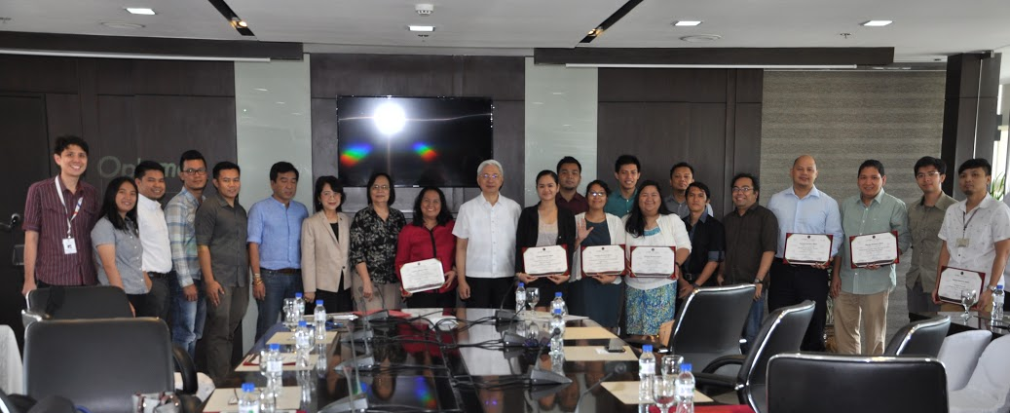
Apr. 8, 2016 IDI Awards (7 UPD IDI Awardees)

Slide 7
Apr. 8, 2016 IDI Awards (6 UPLB IDI Awardees)

Slide 8
IDI Awardees (June 2016)
Execom Recommendation | Diliman | Los Baños | Manila | Visayas | Mindanao | TOTAL
Approved | 9 | 11 |  |  |  | 20
Approved UM | 4 |  |  |  |  | 4
Copyright application | 1
Conditional approval | 2 | 1 |  |  |  | 3
Further PAS | 1 | 2 |  |  |  | 3
Further R&D | 1 | 1 |  |  | 1 | 3
Further review and discussion | 1 |  |  |  |  | 1
For presentation |  |  |  | 1 |  | 1
For funding support |  |  | 1 |  |  | 1
Lack inventive step | 1 |  |  |  |  | 1
Not patentable |  | 1 |  |  |  | 1
TOTAL | 20 | 16 | 1 | 1 | 1 | 39

Slide 9
IDI Nomination Process

Slide 10
Pre-nomination phase CU-TTBDO
IDI Application Form submission
Full IDF submission with signature of all inventors and supporting docs
Prior art search (PAS) by in-house techtrans officer

Slide 11
Nomination phase Execomm
Submission of required docs – IDI, IDF, PAS report, co-inventor’s agreement and deed of asignment
Presentation of PAS results for IDI nomination
Recommendation of Execomm

Slide 12
Post-nomination phase UPS-TTBDO
Endorsement to OP thru OVPAA
Voucher processing
Notice of award

Slide 13
APPLICATION FORM FOR INVENTION DISCLOSURE INCENTIVE (IDI)

Slide 14
BRIEF OVERVIEW OF THE INVENTION
Title: Title of Your Technology. You can use your Thesis/ Dissertation’s Title.
What problem does your invention solve and how does it work?(Attach, if any, publications and draft future publications related to the invention) | The field of invention (drugs, medical devices, etc.) Publications can be attached, or more preferred, e-mailed to cagayaresttbdo@gmail.com
Describe the development status. (concept only, laboratory tested, prototype, etc.) | Are there finished products? Are there field trials or clinical trials?

Slide 15
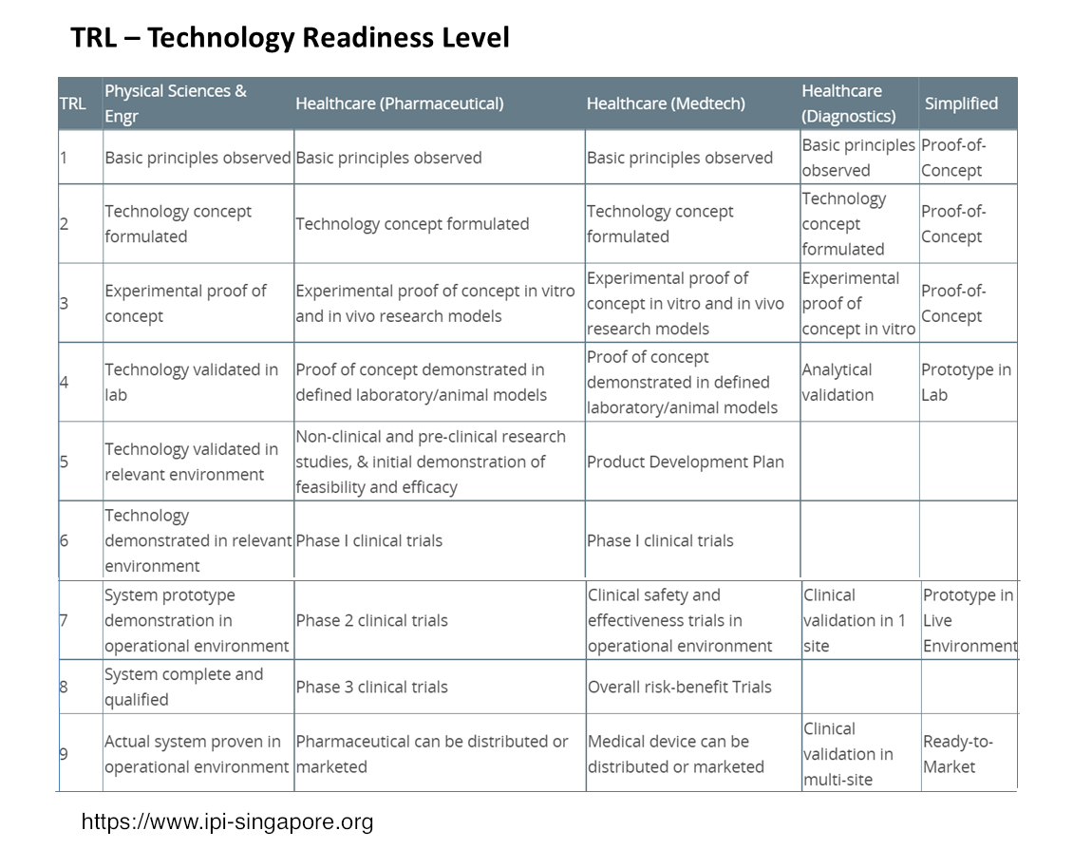

Slide 16
COMMERCIAL POTENTIAL OF THE INVENTION
Who are the potential customers of your invention? (Cite your industry contacts, if any.) It’s preferred that specific names are added here so we can coordinate with them as potential tech partners | Name:________________________________________________ □User □Manufacturer □Distributor □Investor □Other:_________ Type of Industry: _______________________________________ Name:________________________________________________ □User □Manufacturer □Distributor □Investor □Other:_________ Type of Industry: _______________________________________
Competitive advantage | State what are the benefits of your technology vs current techniques/ products Ex: less expensive? More user-friendly? More effective?

Slide 17
CONTACT DETAILS
Name(Last, First, Middle):
Home Address:
Office Address :
Telephone No.: | Cellphone No.
Email Address:

Slide 18
Exercise and Q&A
TTO’s will come to you with the form and assist you in fulfilling them.
The floor is open for any questions regarding the IDI.

